Slide 1



Automation Testing for Laundry Service Mobile App
Presented By
Presented To
Mehedi hasan - 201002085
Monisha Akter Asha– 201002078
Maruf Mazumder-201002191
MD. Zahidul Hasan
Enhancing Quality and Efficiency

Slide 2

AGENDA
Introduction​
About project
Challenges
Tools
​ Sample Test Cases
Automation Result
App Testing Future
Conclusion​

Slide 3
Introduction
The laundry service mobile app aims to provide users with a convenient and efficient way to schedule and manage their laundry services. Automation testing plays a crucial role in ensuring the reliability and quality of the app, contributing to a seamless user experience.

Slide 4
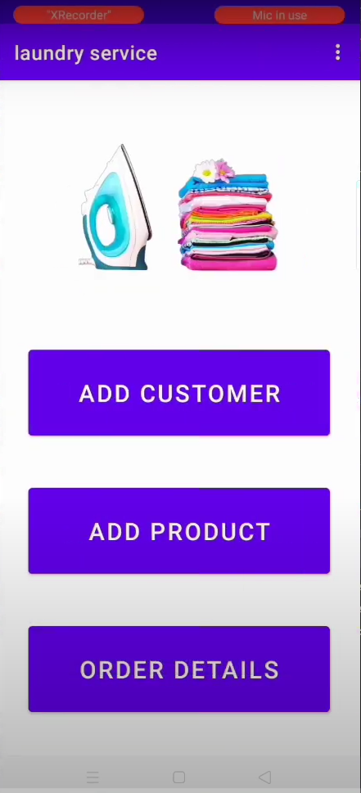
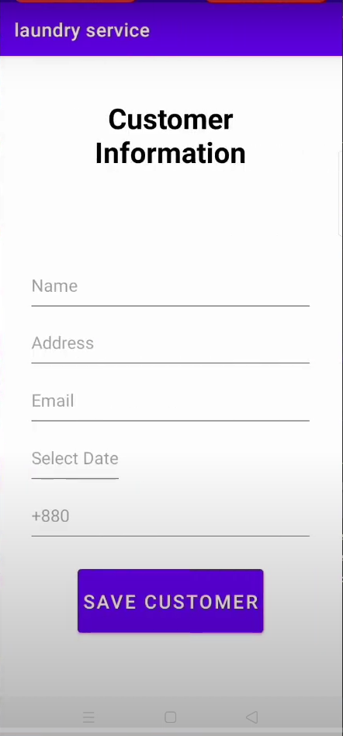
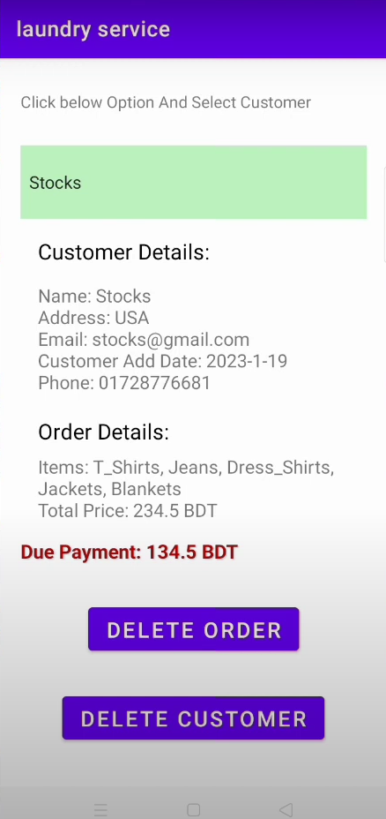
About project

Slide 5
Challenges in Laundry Service App Testing
Performance
Regression
SANTOSHI​
Functional
Unit
Integration

Slide 6
Test Automation Tools for Mobile Apps
Junit Environment setup
Android Studio

Slide 7
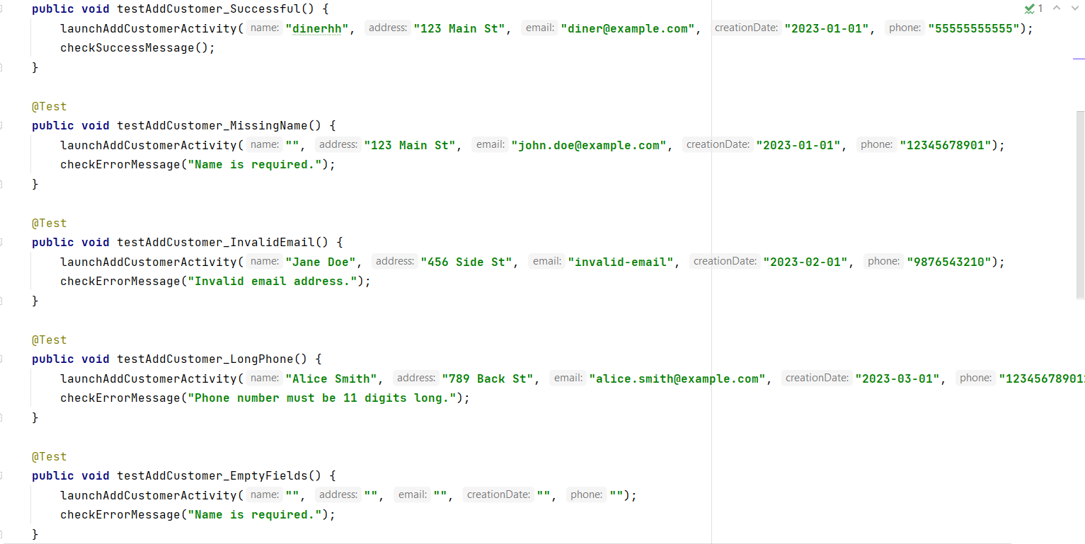
Sample Test Cases for Laundry App

Slide 8
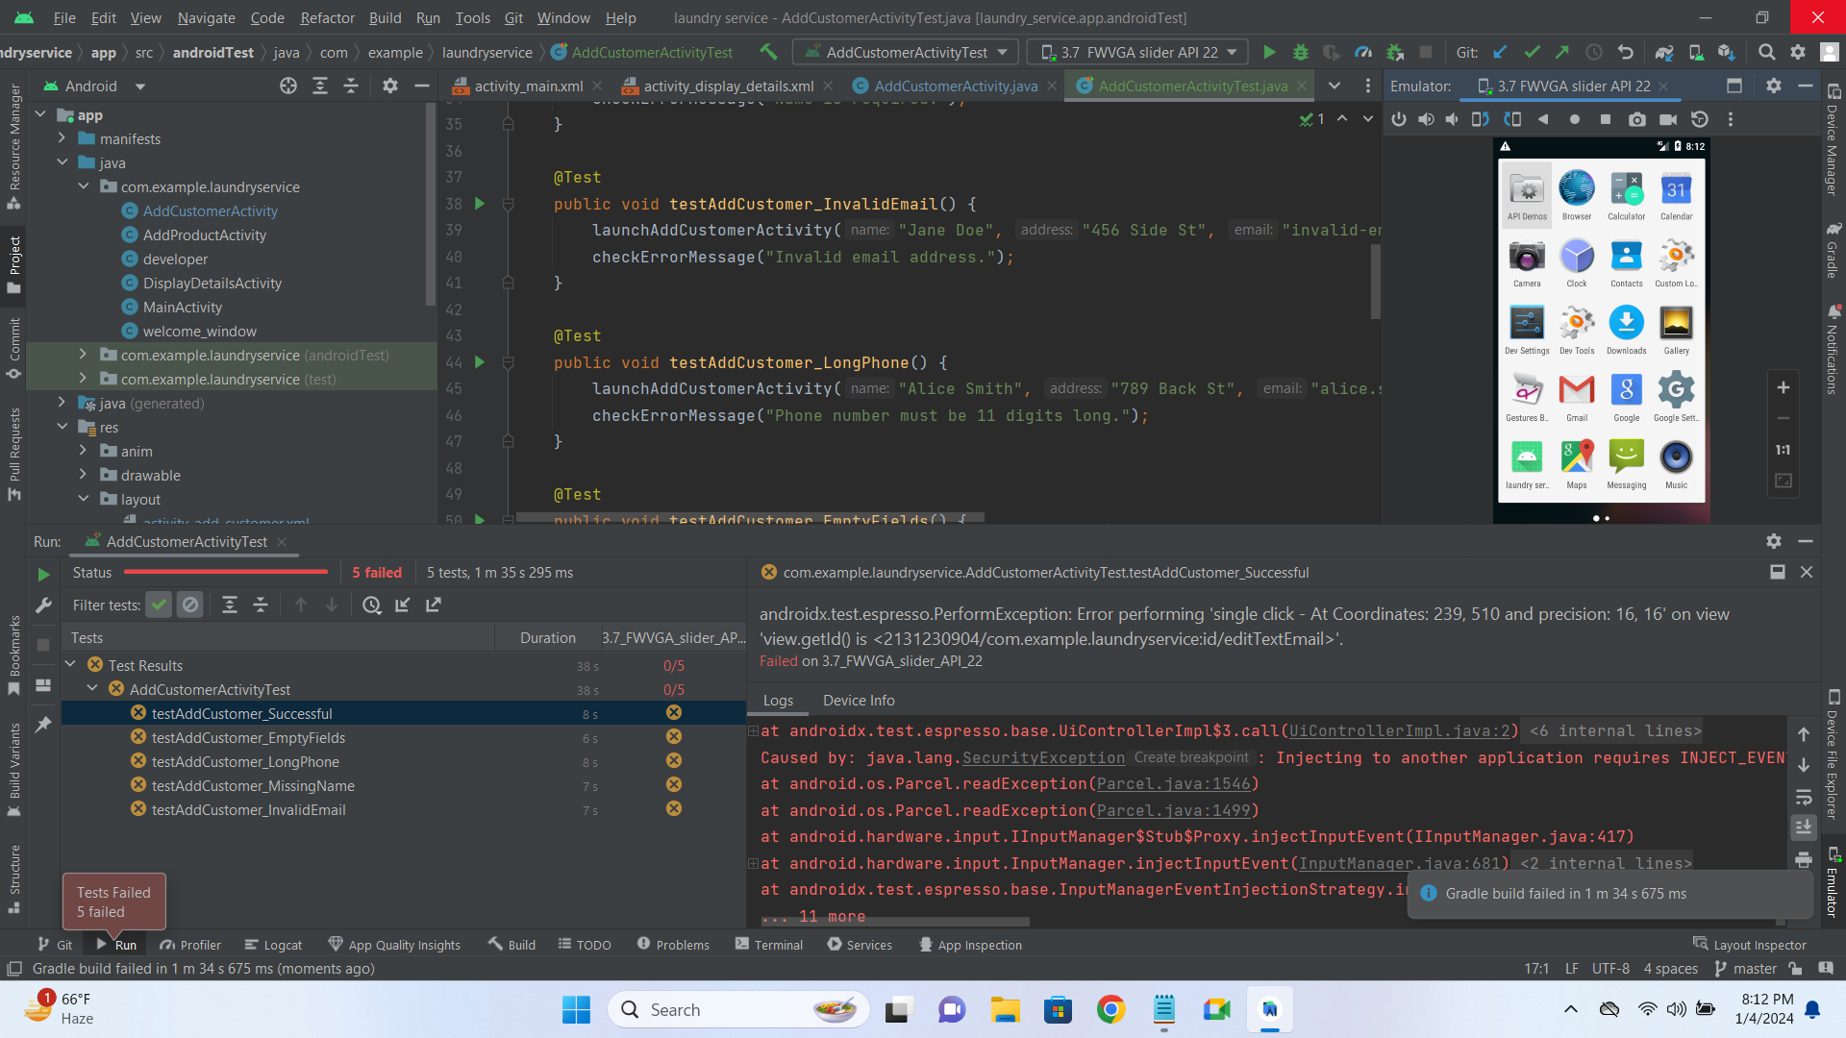
Case Study: Successful Automation

Slide 9
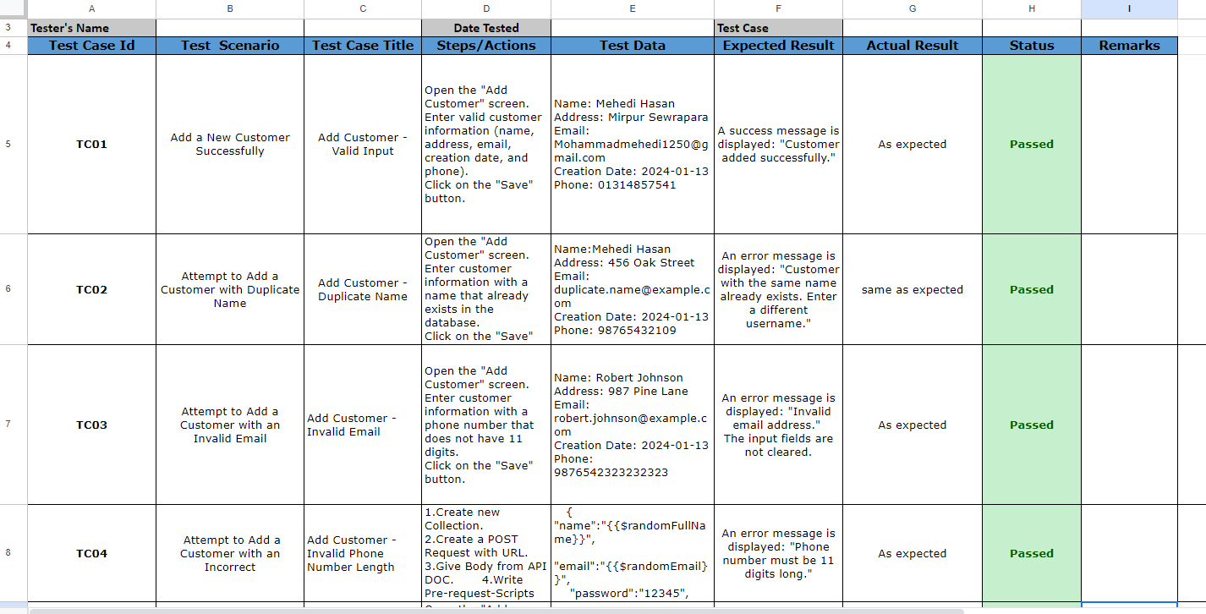
Manual Testing

Slide 10
Future of Mobile App Testing
10
AI and ML Integration
DevOps Integration
Codeless Automation
Cross-Platform Automation
Enhanced Security Testing
User Experience (UX) Testing

Slide 11
Conclusion
Successful implementation of automation testing fortifies the Laundry Service Mobile App, ensuring reliability and user satisfaction. Overcoming challenges and embracing future trends set the stage for sustained growth in the dynamic mobile app landscape. Our commitment to quality remains unwavering.

Slide 12
THANK YOU
Mehedi Hasan
Monisha Akter
Maruf Mazumdher

